Slide 1


DrugDev
New Product Development System
Group Members
Affan Khan 22i-1215
Abdul Wasay 22i-947
Abdul Majeed 22i-1216

Slide 2

Project Overview
Purpose:
To digitize and centralize drug development processes in the pharmaceutical industry.
Key Features:
Automated workflows for research, trials, approvals, and compliance.
Real-time monitoring of drug development progress.
Integration of regulatory requirements to ensure compliance.
Goals:
Streamline operations and reduce manual errors.
Minimize the time required to develop and approve new drugs.
Improve collaboration among researchers, regulators, and manufacturers.
Target Users:
Pharmaceutical companies, regulatory authorities, and research organizations.

Slide 3
Functional Requirements
1.⁠ ⁠Submit New Idea
Record idea details with unique ID and initial status.
2.⁠ ⁠Review Idea
View, filter, sort ideas.
Add reviewer comments.
3.⁠ ⁠Approval by M-Level
Approve/disapprove pending ideas.
Update status to "Approved by M-Level."
4.⁠ ⁠Approval by C-Level
Review M-Level approved ideas.
Update status to "Approved by C-Level."
5.⁠ ⁠Track Idea
View status updates and progress timeline.
6.⁠ ⁠Regulatory Compliance
Prepare and approve compliance documents.
Update status to "Approved Compliance."
7.⁠ ⁠Sales Plan
Develop and generate sales plans with templates.
8.⁠ ⁠Manage Testing
Track test progress and results.
Approve or request retesting.
9.⁠ ⁠Product Launch
Plan and track launch milestones.
Update status to "Launch."

Slide 4
Non- Functional Requirements
1.⁠ ⁠Performance Requirements
Supports up to 100 simultaneous users without degradation.
2.⁠ ⁠Safety Requirements
Ensures data integrity and accuracy for regulatory compliance and patient safety.
3.⁠ ⁠Security Requirements
Adheres to global data protection regulations.
Guarantees secure storage and transmission of sensitive data.
4.⁠ ⁠Software Quality Attributes
Reliability: 99.9% uptime.
Usability: Intuitive interface for users with varying technical expertise.
Maintainability: Modular, well-documented code for easy updates.
5.⁠ ⁠Business Rules
Only authorized personnel can approve ideas.
All data submissions must be audited and traceable.
6.⁠ ⁠Operating Environment
Runs on standard hardware and integrates with major databases and cloud platforms for scalability.

Slide 5
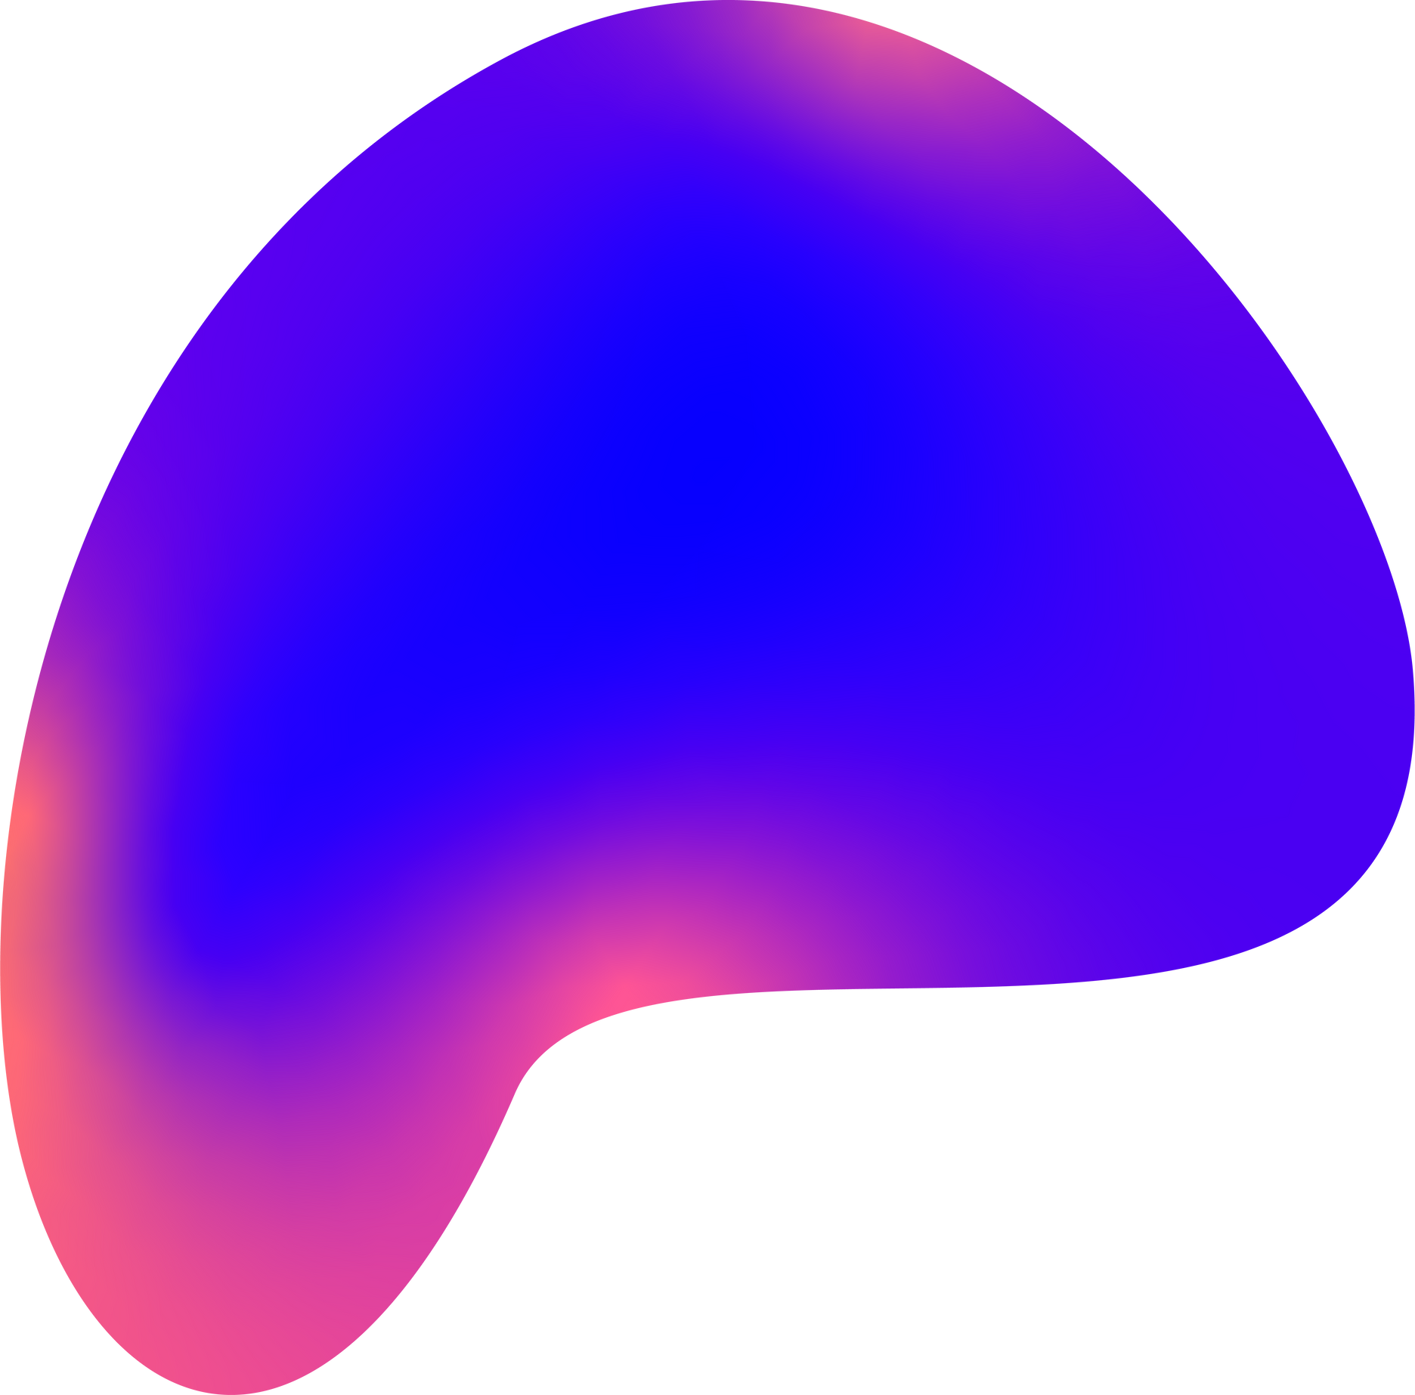
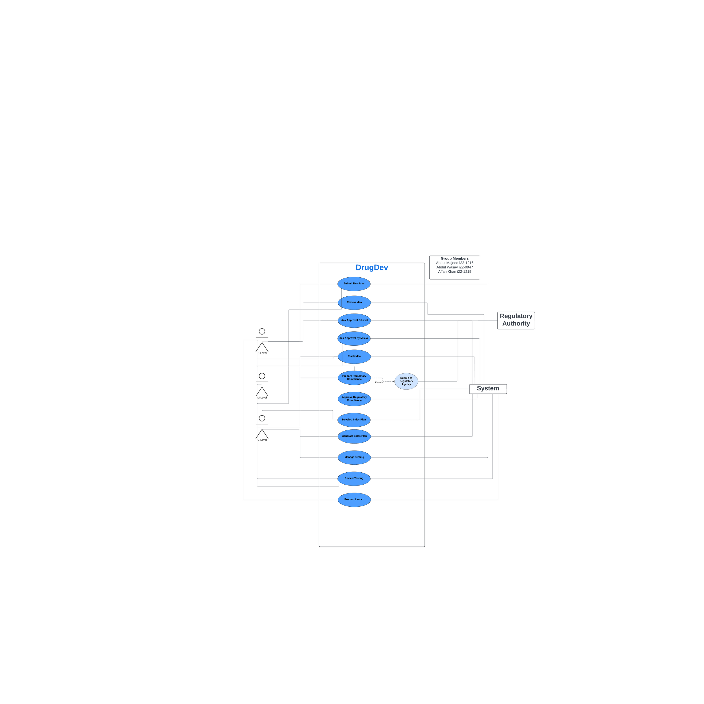
Use Case Diagram

Slide 6

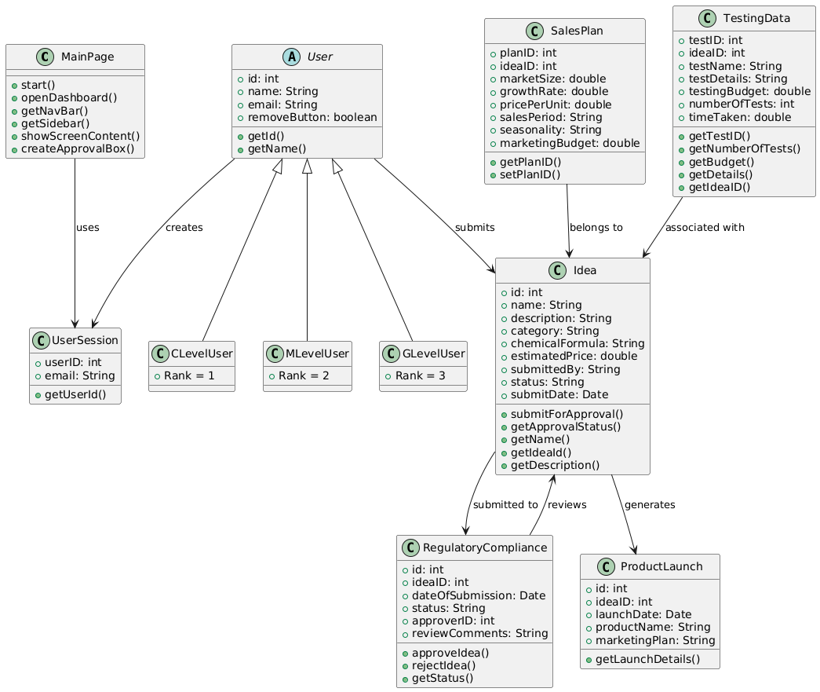
Class Diagram

Slide 7

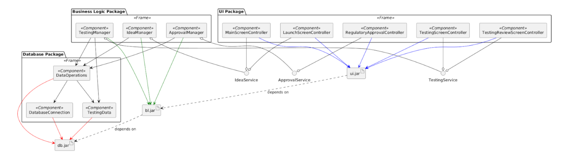
Component Diagram

Slide 8
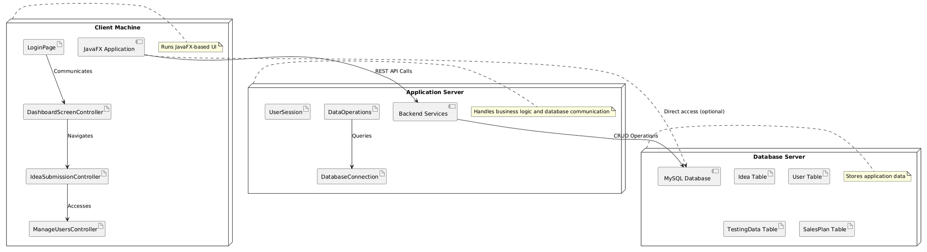
Deployment Diagram

Slide 9
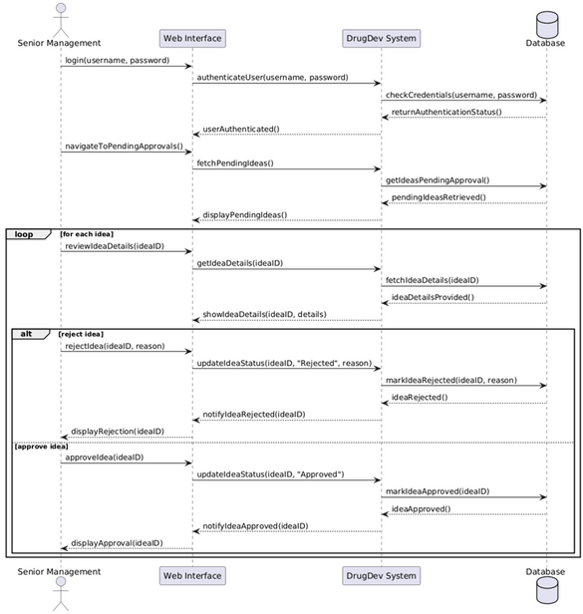
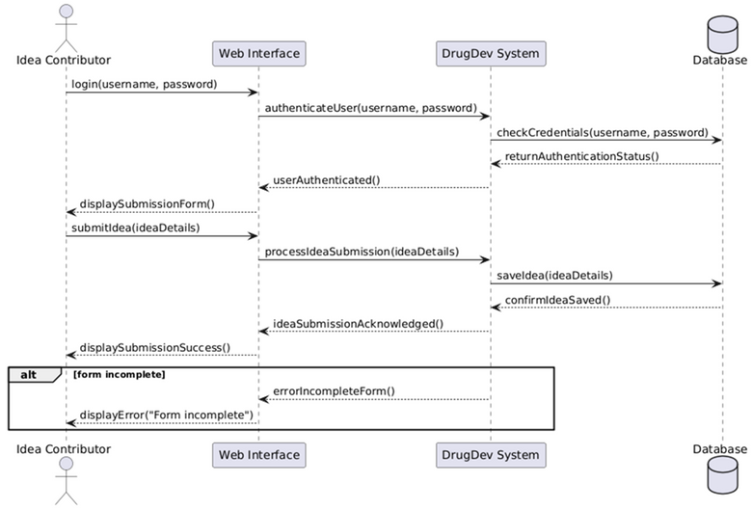
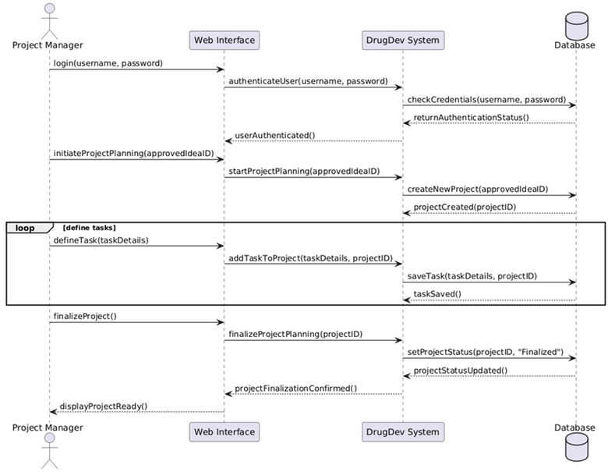
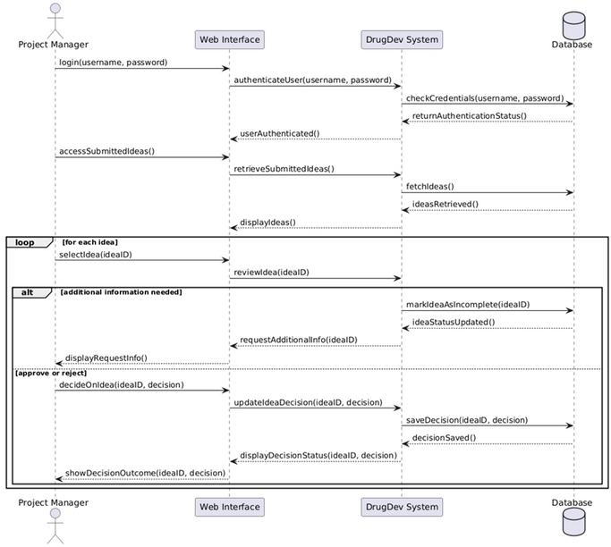
Sequence
Diagram

Slide 10
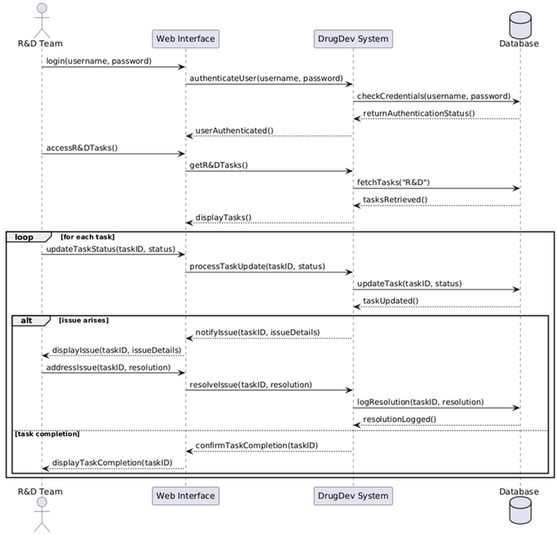
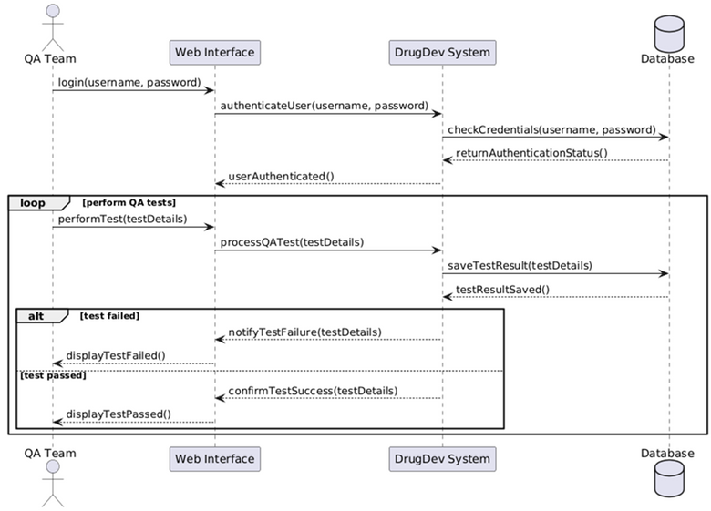
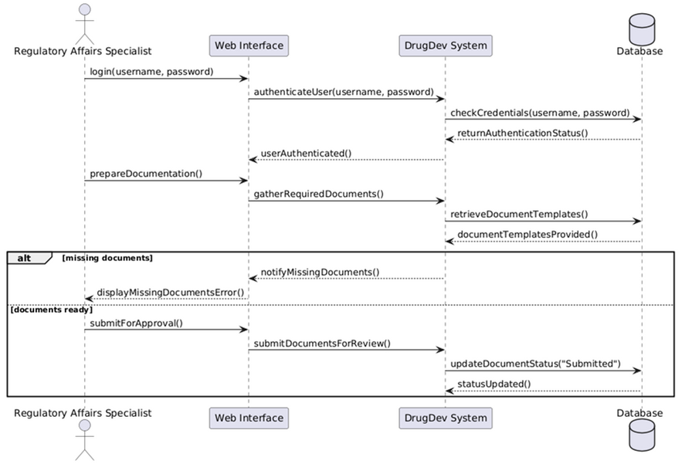
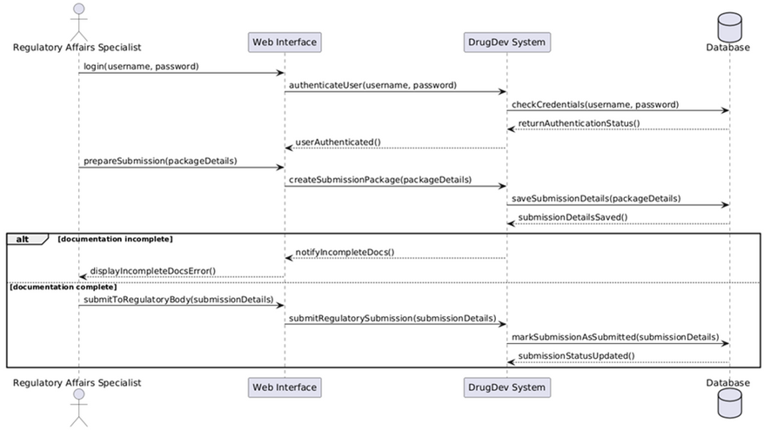

Slide 11
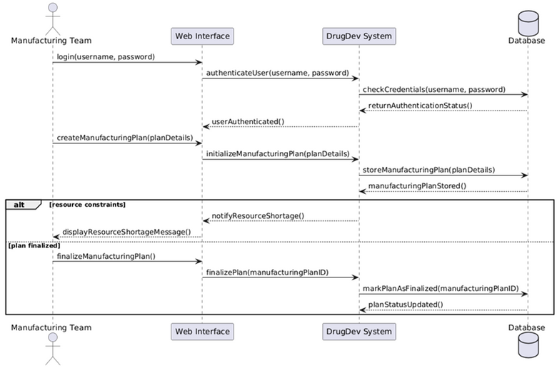
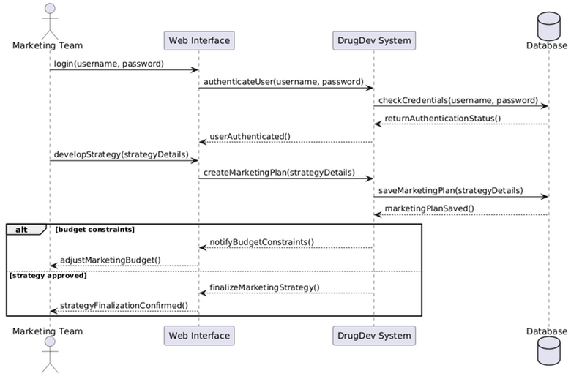
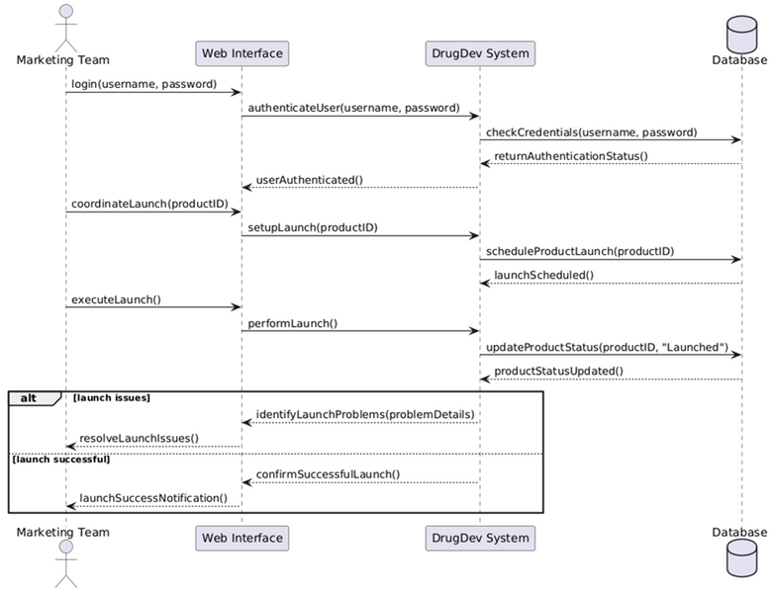
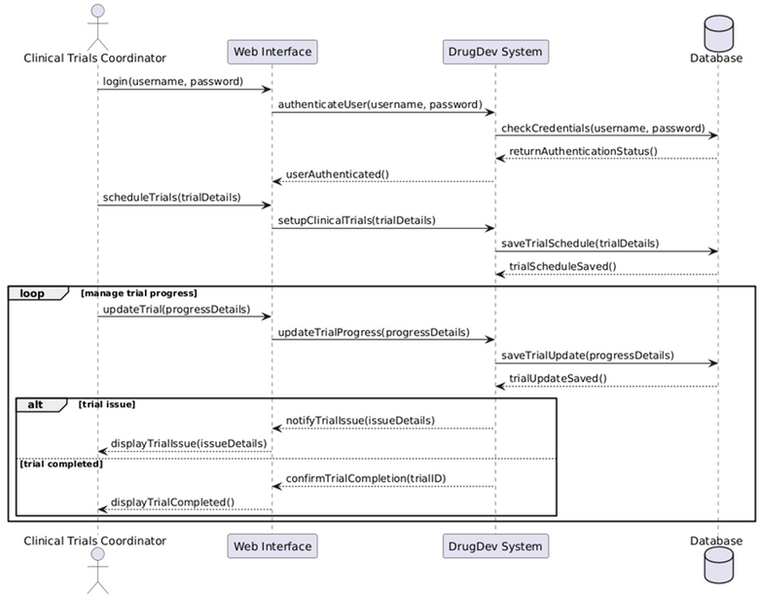

Slide 12
UI of DrugDev

Slide 13
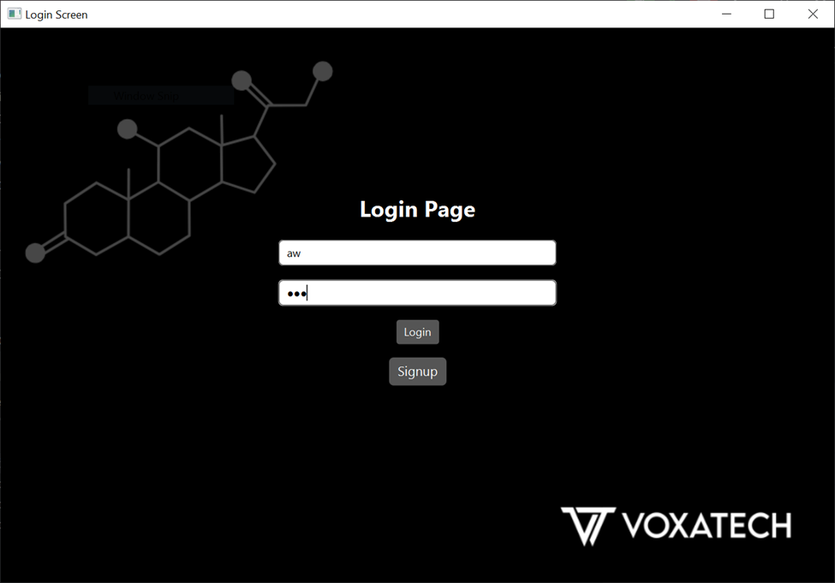

Slide 14
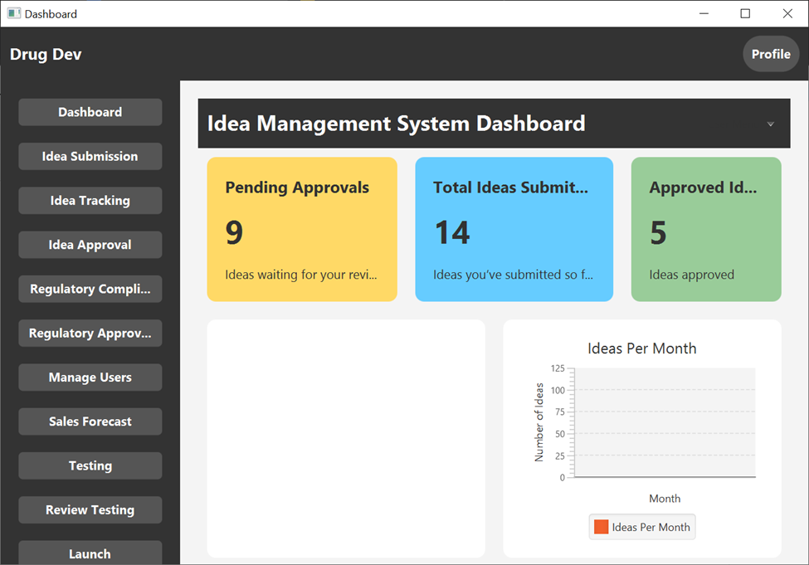

Slide 15
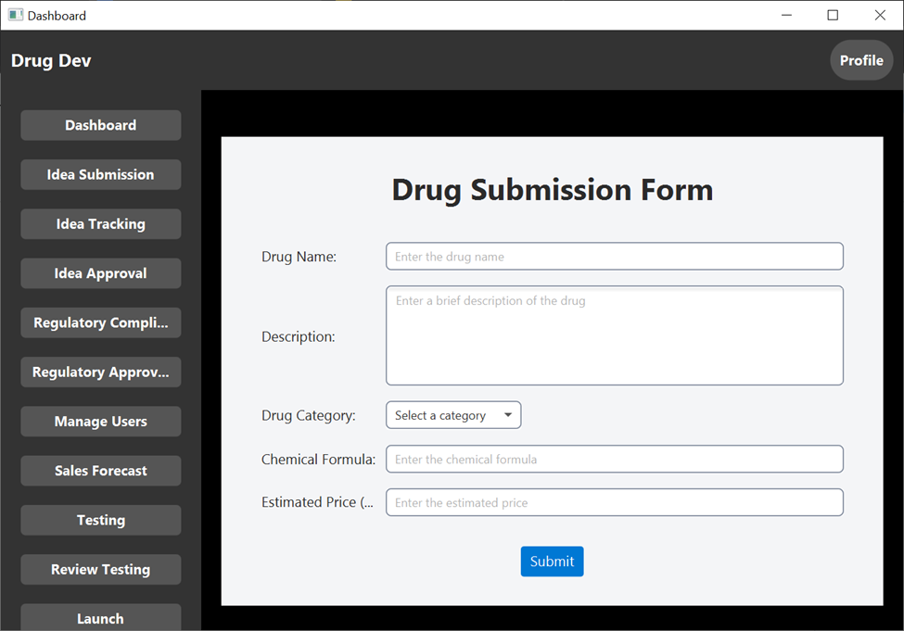

Slide 16
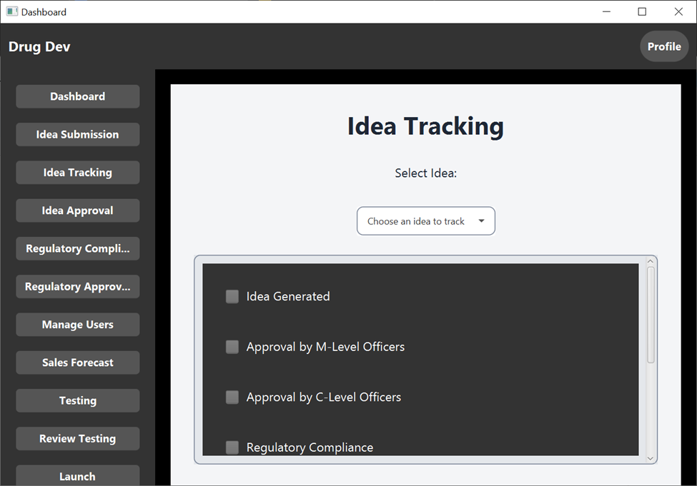

Slide 17
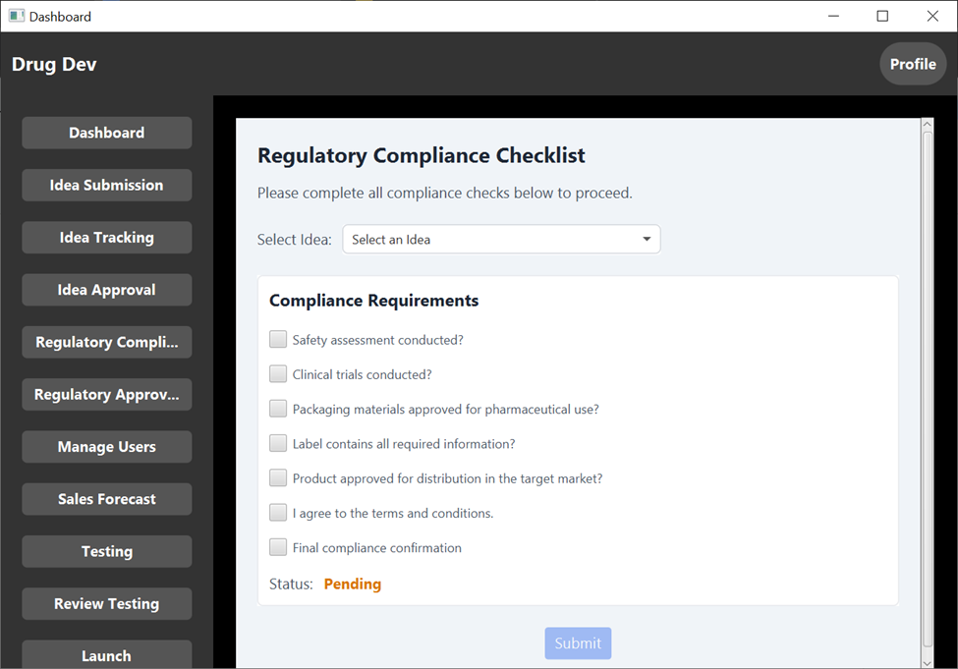

Slide 18
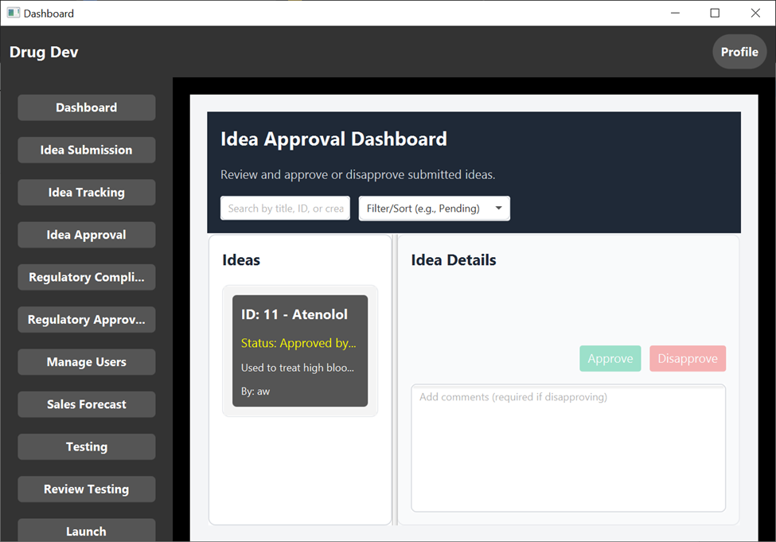

Slide 19
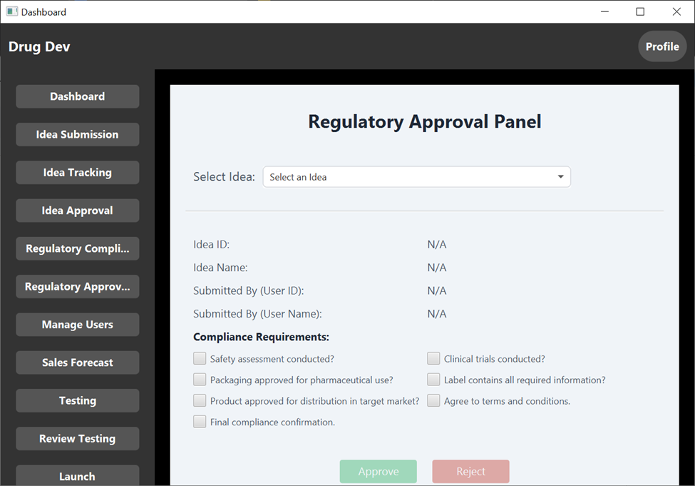

Slide 20
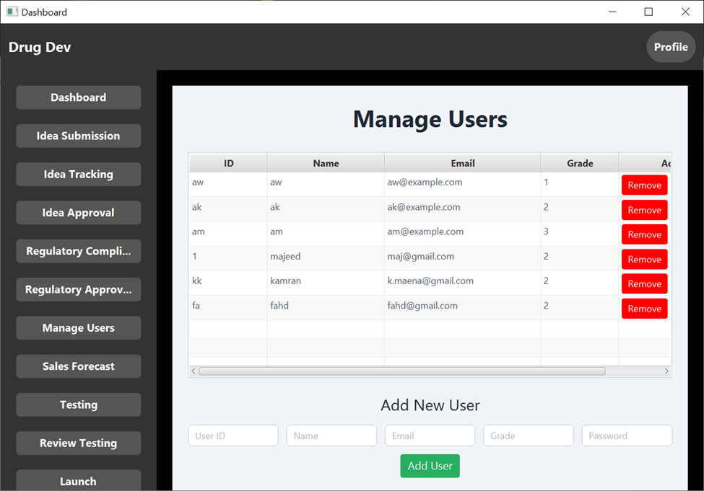

Slide 21
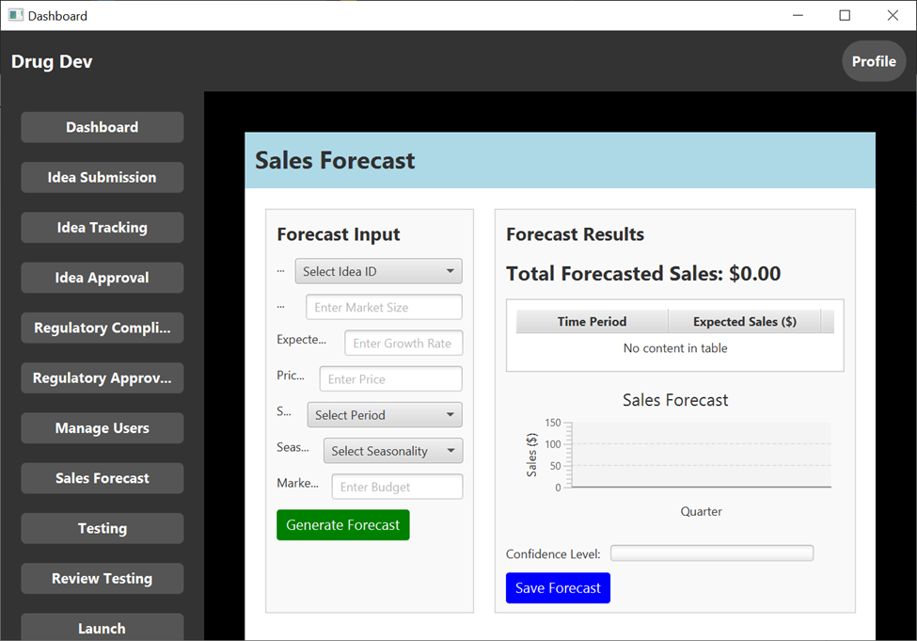

Slide 22
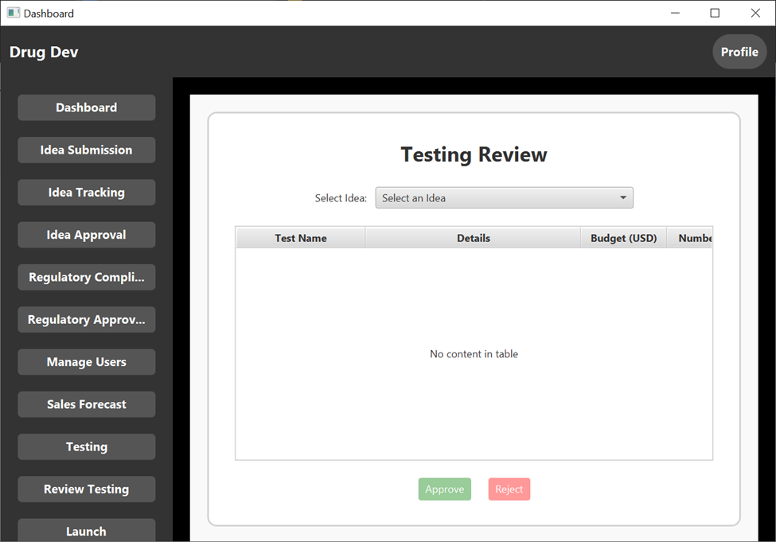

Slide 23
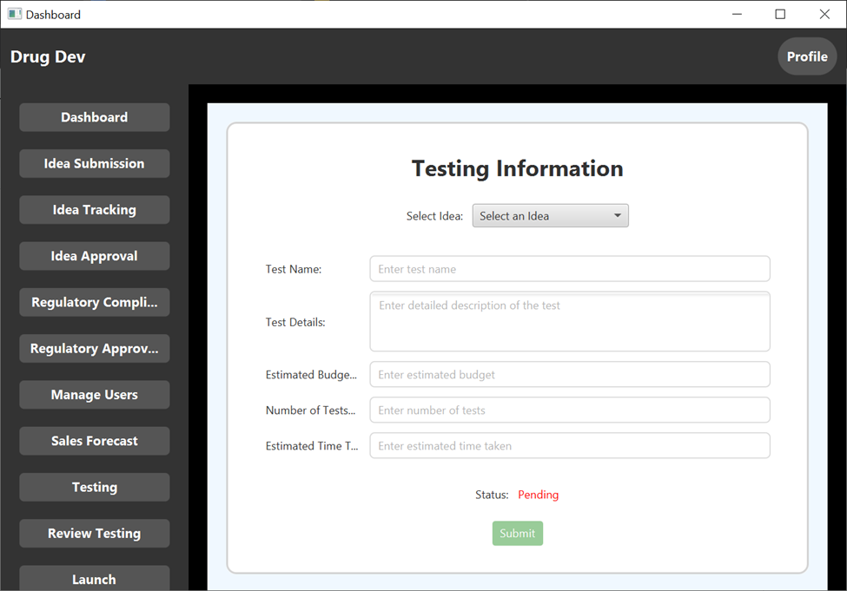

Slide 24
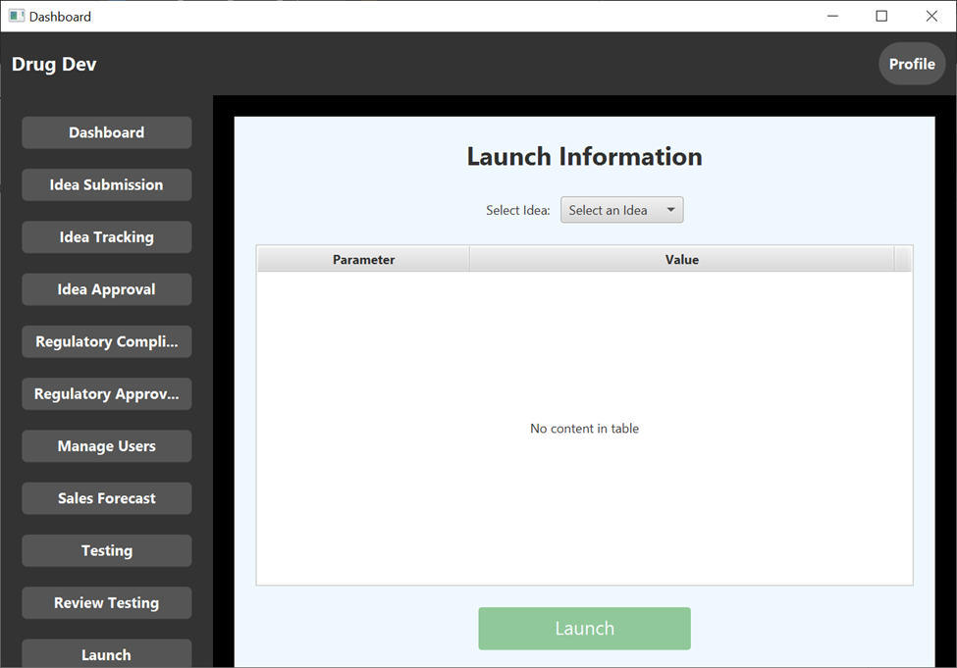

Slide 25

Design Patterns
1. Singleton Pattern in database connection
Justification:
Where: DatabaseConnection.java
Justification:
"The DatabaseConnection class implements the Singleton pattern by maintaining a single shared instance of the database connection. This ensures efficient resource utilization and prevents multiple conflicting connections."

Slide 26
Design Patterns
2.Singleton Pattern in User Session
Justification:
Where: User session management across the application.
Evidence:
If there's a single session instance used to store details about the currently logged-in user (e.g., username, role, or preferences), this is inherently a Singleton.
Check whether there’s a shared static object, a globally accessible variable, or a similar mechanism for session management.

Slide 27
Design Patterns
3. Strategy Pattern
Justification:
Where: Controllers in the ui package (e.g., LoginFormController.java)
Example Justification:
The LoginFormController and other controllers utilize the Strategy pattern to dynamically handle various user actions, such as login and logout. This separation of concerns enhances flexibility and modularity.

Slide 28
Design Patterns
4. Observer Pattern
Justification:
Where: Views like IdeaTrackingView.java and business entities like Idea.java
Justification:
The IdeaTrackingView interacts with Idea objects in a manner consistent with the Observer pattern, where the view observes changes in the data and updates dynamically.

Slide 29
GRASP Patterns
1. Controller
Justification:
Where: Controllers in ui (e.g., LoginFormController, DashboardScreenController)
Evidence: These classes handle user inputs and coordinate between views and the backend logic.
"The LoginFormController adheres to the GRASP Controller pattern by managing user input, orchestrating application logic, and delegating tasks to the business layer."

Slide 30
GRASP Patterns
2. Information Expert
Justification:
Where: Business logic classes like User.java, Idea.java, TestingData.java
Evidence: These classes encapsulate data and methods closely tied to the data they own.
"The Idea class demonstrates the Information Expert pattern by encapsulating attributes like title and description and providing methods for operations directly related to its state."

Slide 31
GRASP Patterns
3. Low Coupling
Justification:
Where: Separation between ui, bl, and db layers.
Evidence: Different layers focus on distinct responsibilities, reducing dependencies.
"The code achieves low coupling by separating concerns across ui, bl, and db layers, ensuring each component can evolve independently."

Slide 32
GRASP Patterns
4. High Cohesion
Justification:
Where: Smaller classes like DatabaseSetup.java, SidebarView.java
Evidence: These classes focus on specific, well-defined tasks.
"The SidebarView class exhibits high cohesion by exclusively managing the sidebar's UI logic, making the code more readable and maintainable."

Slide 33

Thank You

